Slide 1
Version Control with Git and GitHub

Slide 2
What’s the plan for today?
Version Control - Concepts, Terminology
Git – Commands
Collaborating with Git using GitHub
Version Control practices and workflow in the industry.
Notes:
This talk is divided into few smaller chunks.
First we will establish the need of a versioning system and tools and the problem it solves
Then we’ll see how git can be used to track codebase changes and also collaborate
Best practices used in industry.

Slide 3
How do you work with other developers?
Work in a team, probably on particular components ?
Integrate your code together.
Make copies of your files in case something you lose them. (Not really?)

Slide 4
So what’s version control?
Version control is the management of changes to documents, primarily computer programs.
Also known as revision control or source control.
Examples: git, mercurial, subversion

Slide 5
Why version control?
Makes working in a team easy!
Code without interference.
Go back to a previous version (iOS 10 anyone?)
Integrate code of multiple developer’s easily.
Know who did what, when.
Keep your code secure.

Slide 6
Do you really need version control?

Slide 7
Do you really need version control?

Slide 8
Git
A distributed version control system
Command-Line Tool (accessible with Terminal on the Mac or Git Bash on Windows)
Notes:
Git is a distributed version control system. A version control system is a tool that allows us to manage changes made to blobs. Which can be
It is a tool that allows you to track your code history. Allows you to peek into the past and see what a code looks like at any given point of development.
An important tool to collaborate with other fellow developers. As developers you can’t collaborate efficiently by sending pieces of code in a zip file, or sharing it over the folder.
Pro Tip: if a company shares it code over transfer folder or network drive it isn’t the company for a developer to join. Period! ☺
Source of truth, it is important to track down developers who made the changes and what changes are done.

Slide 9
Why Git and not other VCS?
Git’s the most popular version control system in the industry, by far.
A proper and detailed understanding of Git will allow you to make a transition to any other distributed VCS easily.
Most popular VCS are similar to Git
Notes:
Well there are couple of reasons
Developers need to share codebase easily
Keep track of all changes , undo, redo or time travel over months of development and compare code base.
Maintain working copies of same code base
Communicate changes made
Still need a reason to learn?
It is a industry wide tool that is being used by thousands of developers everyday. If you don’t know it probably you’ll never be able to collaborate with them
It is super powerful once you know. Employers expect you to know Git basics and have proficiency.

Slide 10
Installing Git
Things you’ll need:
You need Git installed on your system, and you can access it in a UNIX Terminal, either the Terminal on the Mac or Git Bash on Windows.
Download Git from the following link:
https://git-scm.com/downloads

Slide 11
Version Control Terminology
Version Control System (VCS) or (SCM)
Repository
Commit
SHA
Working Directory
Checkout
Staging Area/Index
Branch

Slide 12
Version Control Terminology
Version Control System :
A VCS allows you to: revert files back to a previous state, revert the entire project back to a previous state, review changes made over time, see who last modified something that might be causing a problem, who introduced an issue and when, and more.
Repository:
A directory that contains your project work which are used to communicate with Git. Repositories can exist either locally on your computer or as a remote copy on another computer.

Slide 13
Version Control Terminology
3. Commit
Git thinks of its data like a set of snapshots of a mini file system.
Think of it as a save point during a video game.
4. SHA
A SHA is basically an ID number for each commit.
Ex. E2adf8ae3e2e4ed40add75cc44cf9d0a869afeb6
5. Working Directory
The files that you see in your computer's file system. When you open your project files up on a code editor, you're working with files in the Working Directory.

Slide 14
Version Control Terminology
6. Checkout
When content in the repository has been copied to the Working Directory. It is possible to checkout many things from a repository; a file, a commit, a branch, etc.
7. Staging Area
You can think of the staging area as a prep table where Git will take the next commit. Files on the Staging Index are poised to be added to the repository.
8. Branch
A branch is when a new line of development is created that diverges from the main line of development. This alternative line of development can continue without altering the main line.

Slide 15
Let’s dive into the good stuff now
GIT COMMANDS:
(THINGS WE’LL COVER)
BASIC GIT COMMANDS
REMOTE REPOSITORY – PUSH & PULL
BRANCHING, TAGGING AND MERGING
DISASTER HAS STRUCK!

Slide 16
Basic Git Commands
git init
git status
git add <filename> / git add .
git commit / git commit –m “commit message”
git log –oneline / git log —stat
git clone
Other commands like git show, git ignore, git diff etc.

Slide 17
Demo

Slide 18
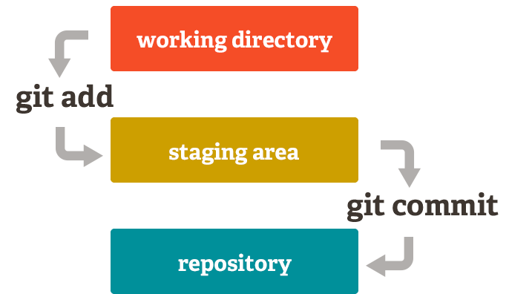
Basic Git model locally

Slide 19
Basic Git Commands
git init – Initialize a Git repository/working directory
git status – Status of your working directory
git add <filename> or git add . (for all files in your working directory)
git commit – Stash changes in your working directory
git log –oneline – View your commit history
git clone – Create an identical copy

Slide 20
GitHub
It’s a hosting medium/website for your Git repositories
Offers powerful collaborative abilities
A good indicator of what you code/how much you code/quality of your code

Slide 21
Working with a remote repository
Remote?
It’s the place where your code is stored.
By default, remote name is origin and default branch is master.
Certain things that come to play, namely collaboration.
How are we going to handle that with Git.
So here comes, push, pull, branching, merging, forking.

Slide 22


Alice
Notes:
Alice builds a semi-calculator app that just adds and subtracts numbers. And saves it to local directory

Slide 23

Alice
Bob
Notes:
Bob also designs a calculator that can multiply and divide numbers. And adds one more file to it.

Slide 24
Alice
Bob
Joe
Notes:
The genius Average Joe changes all the file thinking the calculators were wrongly designed. Hence, changes everything and replaces the files in directory.

Slide 25


Alice
Bob
Joe
Who replaced the files? When ?
Notes:
Over the weekend everyone thinks they have created a great calculator and which safely resides in directory. But on Monday nobody knows who made the change to the files.
Joe is too drunk to realize he was the one who replaced the files!. Perfect Recipe for disaster.

Slide 26
How to access GitHub
Access it on github.com
Create an account if you don’t already have one.
GitHub Clone link:
github.com/intley

Slide 27
GitHub Demo

Slide 28
More Git commands
git push – push your changes into the remote repository
git pull – pull your latest changes from the remote repository
git branch – view branches in your repository
git branch <branchname> - create a branch
git checkout <branchname> - move to that branch
git merge <branchname> - merge into that branch

Slide 29
Demo

Slide 30
Collaboration with GitHub
Remote Repo
Master
C1
Alice
Bob
C2
Notes:
Now that we know how we can track our codebase. Next important thing we have to learn is, to use git as a tool to collaborate with other developers.
So, here is where remote repositories come into play. Many companies like Bitbucket and Git hub are based on hosting these remote repositories.
FYI Git hub and Git are not same. ☺

Slide 31
Collaborate
Remote Repo
git clone
git clone
Master
Master
Master
C1
C1
C1
Alice
Bob
C2
C2
C2
Notes:
Alice and Bob want to change the Calculator app. Alice is assigned the task to build add/subtract functionality and Bob is supposed to add feature of multiplication/division. First thing, they do is clone the remote repository to local machine.

Slide 32
Collaborate
Remote Repo
Master
Master
Master
C1
C1
C1
Alice
Bob
C2
C2
C2
CA
git add
git commit
CB
git add
git commit
Notes:
Alice adds a new commit to his local repository and Bob has also developed the multiplication feature.

Slide 33
Collaborate
Remote Repo
Master
Master
Master
C1
git push
C1
C1
Alice
Bob
C2
C2
C2
CA
C3
CB
Notes:
Alice pushes the new changes to remote repository

Slide 34
Collaborate
Remote Repo
Master
Master
Master
C1
C1
git fetch
C1
Alice
Bob
C2
C2
C2
C3
CA
C3
CB
Notes:
At this stage, the remote repository is different than the local copy. So before pushing Bob has to first fetch the changes from remote repository. Merge it to the local repo, resolve any merge conflicts and then push the changes to master.

Slide 35
Collaborate
Remote Repo
Master
Master
Master
C1
C1
git merge
C1
Alice
Bob
C2
C2
C2
CA
C3
C3
CB
Notes:
Alice adds a new commit to his local repository and Bob is also developed

Slide 36
Collaborate
Remote Repo
Master
Master
Master
C1
C1
git push
C1
Alice
Bob
C2
C2
C2
CA
C3
C3
CB
CB
Notes:
Bob can now push the changes to remote repository.

Slide 37
Collaborate
Remote Repo
Master
Master
Master
C1
git pull
C1
C1
Alice
Bob
C2
C2
C2
CA
C3
C3
CB
CB
CB
Notes:
Alice now pulls the changes and both of them get both the features. At this stage all the changes made by Alice and Bob are shared across the team with proper track and history.

Slide 38
More on Collaborative Git commands
Deleting a branch
git branch –d <branchname>
Merge conflicts! How do you resolve?
Pull requests ?
git tag –a v1.0 / git tag –a v1.0 <commit sha>
Notes:
Demo on branching. The advantage is you can keep your master branch clean and proceed with parallel development without infecting master.
You can also use branching if you just want to try out some stuff in your app and see how it fairs.

Slide 39

Commit messages
Keep your commits smaller
Commit only the files changed.
Keep your commit messages concise and meaningful
git commit –m “Added more stuff.”
git commit –m “Add: App Logo
Notes:
Some of the best practices that I follow in my development workflow.
Keep your commits smaller. Why ? So, code is unstable it easy to track down which commit has the broken file. Git doesn’t charge you $ per commit
Keep commit messages meaningful

Slide 40
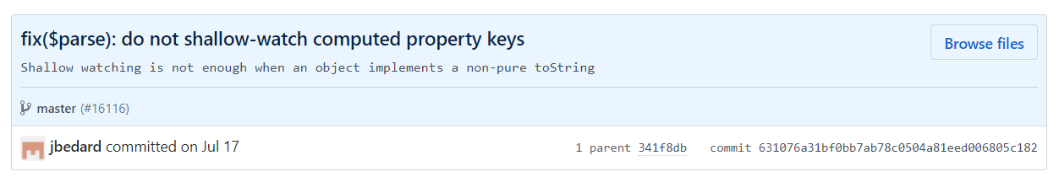
Best practices in Git
Split commit message into Title and Description if it is too complicated
Use verbs like Fix, Add, Change, Update
Commit Messages should be imperative
E.g. AngularJS repo commit

Slide 41
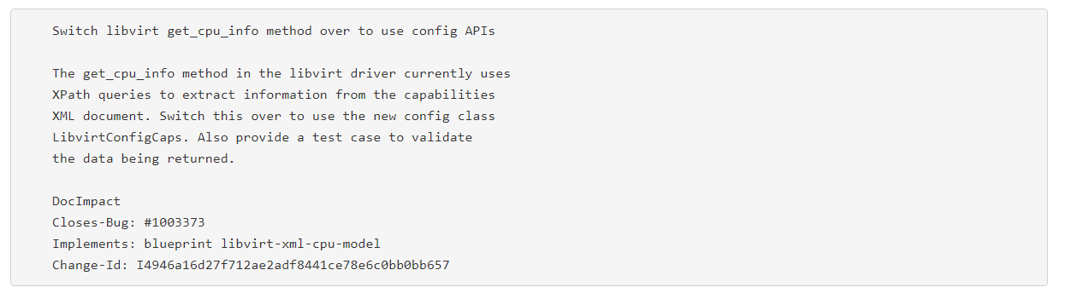
Best practices in Git
Ideal structure
Title
Description
Meta data
Notes:
Title is one liner which states what it does in concise form
There should be one space between title and description. Description should include why it was changed, what was changed etc.
Meta data: may contain external links for additional information

Slide 42
Branching Model
Branches
Master
Develop
Feature
Releases
Hot Fixes
Notes:
Master – is the single source of truth. Holds the code that IS ALWAYS working
Develop – is the secondary branch where the parallel development takes place. Develop branch may further be divided into several feature branches
Feature branch must merge back to develop and not to any other branch.
Release branch – Once you are done with all the feature request changes you can merge all features into develop. Merge develop in Release branch
Although you know that codebase is well tested. For unexpected changes may also have hotfixes branch, which might contain the last minute changes to make the code working
The hot fixes are merged into releases ONLY. And once approved, the releases is merged back to develop as to get the latest changes

Slide 43

Branching Model
Notes:
Explain the diagram

Slide 44
Reads
Successful Git branching model
http://nvie.com/posts/a-successful-git-branching-model/
Gist
https://gist.github.com/jjpatel361/1d97bed699d6e1c419a1f6ed42195eb3
Will be available on DeepCS blog as well. (deepcs.wordpress.com)

Slide 45
So am I Git Ready?
Learning Git is a lot like programming.
Integrating Git and collaborating effectively is a process.
Rebasing, Issuing Pull Requests effectively.
Fast-forward commits
Work on your GitHub profile.
Notes:
So, is that it to learn in git? There is much more to advanced topics that you can learn.

Slide 46
Next Workshop Ideas ?
Feedback forms will be handed out to you. Please do let us know how this workshop went ☺
Tentative Ideas for the next Workshop.
Python Workshop – Build a Movie Trailer Website
RESTful Web Application - Basics

Slide 47
Questions?
Notes:
Please provide us feedback on what did you like about it or think we can improve.

